Slide 1

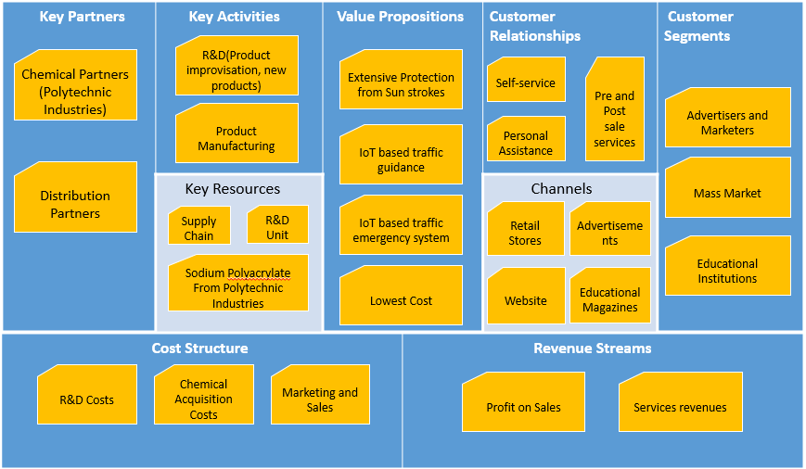
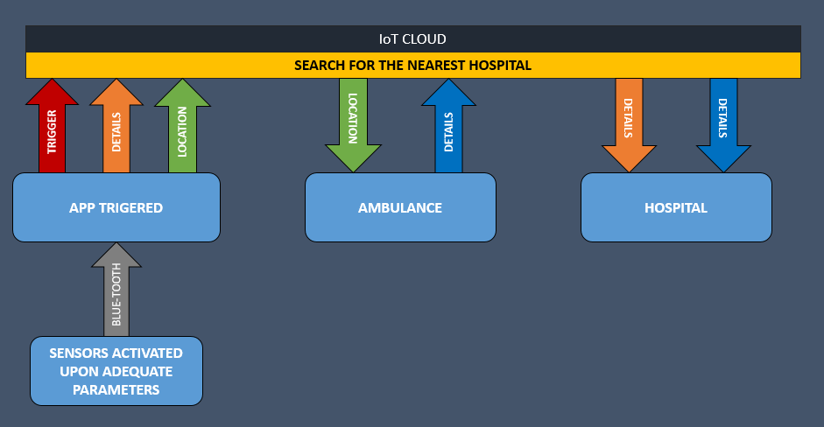
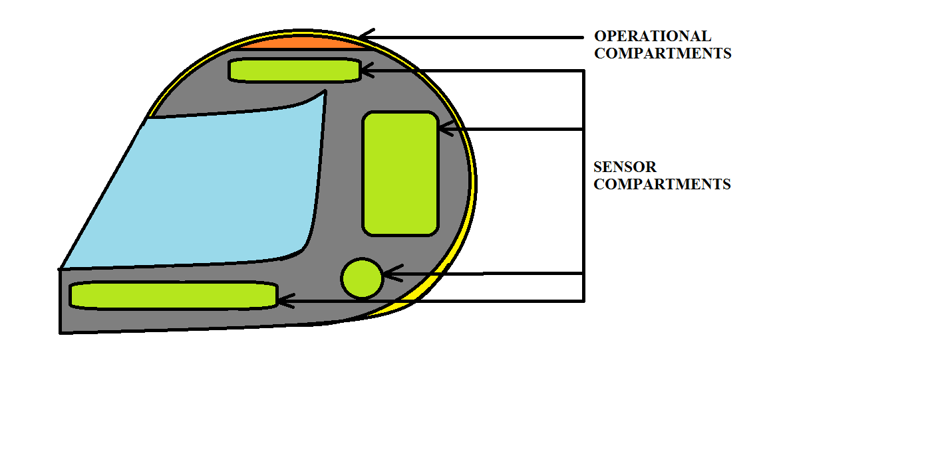
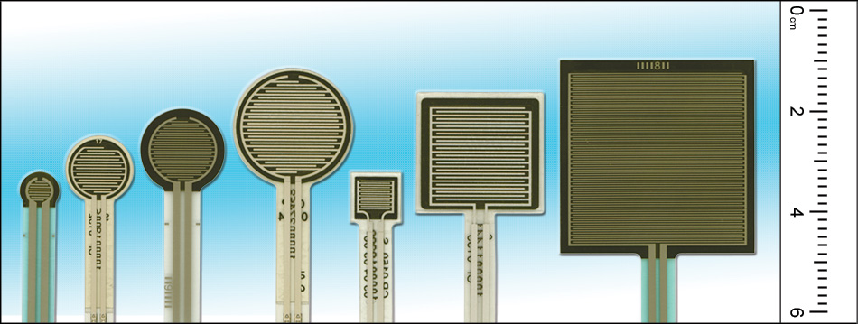
Team No.
08
Team No.
XX
VIT Conclave on Internet of Things - 2015
GOZWHIT- A SMART & SECURE HELMET
BY: SAILESH PATRA, MARLA AKHIL REDDY, CHAVA SAI TEJA, JAGMOHAN SINGH
Abstract
Goal
REVENUE MODEL
This project is aimed at using the concept of Internet of Things(IoT) and chemistry with the rider’s helmet to provide extensive safety, guidance and health care features. The following features are planned to be implemented in phase-wise manner in the project :
1. Internet of Things(IoT) based traffic emergency system
2. Internet of Things(IoT) based traffic guidance system
3. Extensive protection from sun strokes
4. GPS tracking
All these facilities are to be implemented on the helmet with maximum cost efficiency to make the final product within the reach of Indian common man.
The goal of this project is :
To provide advanced traffic safety mechanism through IoT to the people at affordable costs.
To provide IoT based traffic guidance system to the people – first target : Tier-1 cities in India
To provide extensive protection from sun strokes especially during the hot summer season in India
To make this project an innovative platform for many other applications like Easy GPS tracking, Health sensor etc.
Proposed Design
ADVANTAGES
The helmet will be mounted with appropriate sensors at appropriate positions on the helmet. They are calibrated to sense high impact due to any accident or crash.
Once they detect the designated input, the rider’s location is immediately sent to a cloud of hospitals where the nearest hospital is notified about that so that ambulance can reach the spot immediately.
1. Immediate response to any accident by the emergency services since all of them become a part of network(of things).
2. The location of the accident is too updated to the emergency services so that finding the location wont be such a trouble.
3. Details of the personnel is also updated to the emergency service centre so that formalities of paper-work may be completed in before hand.
4.Continues tracking of employees for Companies like logistics, customer service etc.
5.Proper Traffic Guidance using Google Services.
6.Humidity reduction inside Helmet.
7.Many inbuilt Bluetooth facilities like automatic call acceptance(while driving) etc..
Motivation
There has been a multiple-fold rise in number of road accidents in the recent days and many-a-times, the emergency services have faced the difficulty on timely response to the situation.
In large cities, sometimes the emergency services find it difficult to locate the spot of the accident as based on a phone call.
Companies(logistics, customer service) face difficulties in tracking the vehicles of their employees
Even with heavy risk of not wearing helmet, People do it as they find it inconvenient to wear helmet in hot humid sub-Continent conditions. Our new chemical system compartment in helmet solves it.
All these situations prompted us to look into the possibility of IoT coming up helping the people in these cases and we found out that in the initial phases of our project we can use the helmets used by people while driving. Later the same technology can be used on other vehicles to provide and all-round extensive safety mechanism.
CROSS SECTIONAL DIAGRAM
SENSORS USED
About Us
We are a team dedicated for research and development of creative solutions to day-to-day problems. We aim at creating smart, simple, innovative ad cost-effective solutions which could be affordable for the common man of India.
Our Contribution
VIT Conclave on Internet of Things provided us with the exposure to the applications of the concept of Internet of Things(IoT) and several other creative approaches the solve the day-to-day problems by invoking the inter-connection and sharing between the day-to-day products.
Apart from the conclave, we would like to appreciate the suggestions and help from the faculties which proved to be a priceless booster to our project.
1. Force-sensing resistors consist of a conductive polymer, which changes resistance in a predictable manner following application of force to its surface.
2. The sensing film consists of both electrically conducting and non-conducting particles suspended in matrix. Applying a force to the surface of the sensing film causes particles to touch the conducting electrodes, changing the resistance of the film..
Future Work
PROTOTYPE-II : To implement traffic guidance system using Google services. PROTOTYPE-III : To implement fully integrated traffic safety and guidance system
Notes:
1

